Slide 1

Utility Equipment Analysis

Slide 2
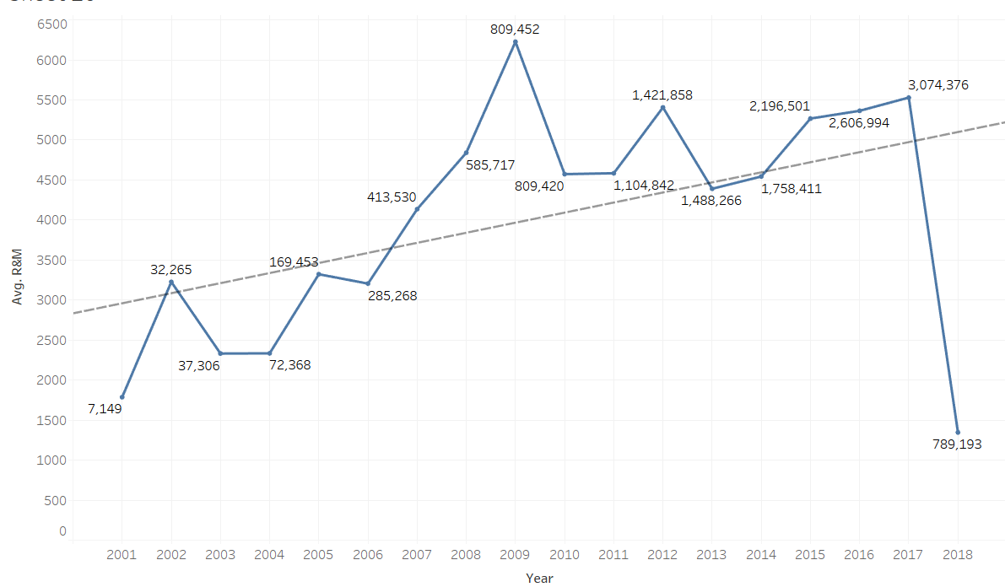
Problem: Average Aerial R&M Costs are Increasing
Notes:
$ 4390 in 2013- $ 5056 in 2017
Percnetage of vehicles of age
Bubble plot,

Slide 3
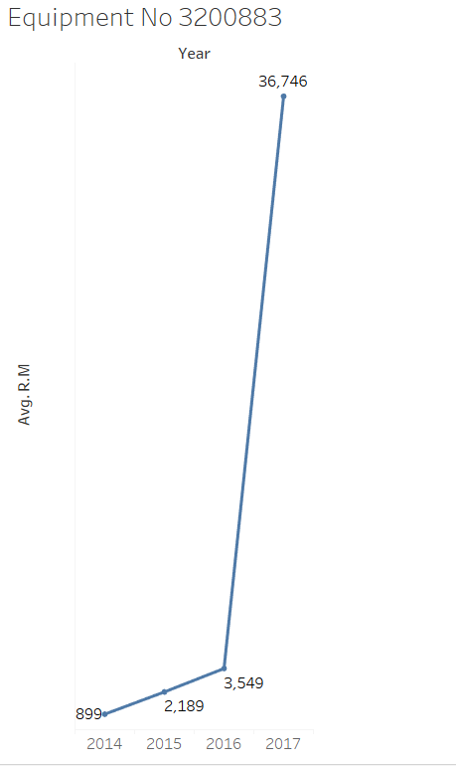
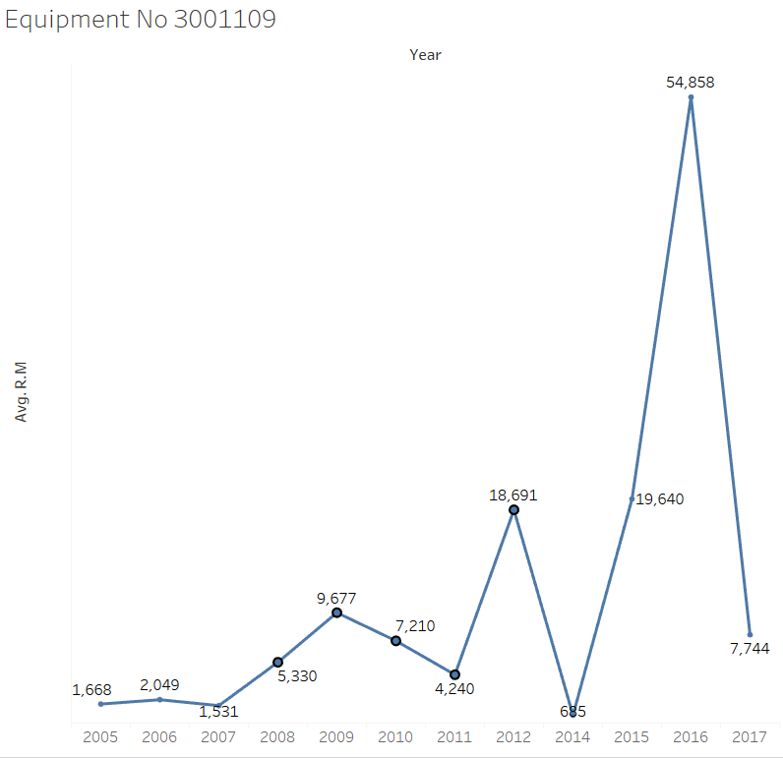
High variability in R&M Costs($): 37% of the Aerials have R&M costs above average(Can save 5.21 M)
Notes:
3200883-Cummins, Freightliner coorp
3001109-Caterpillar, Ford
$5.21 M above the average(Amt which can be saved)

Slide 4
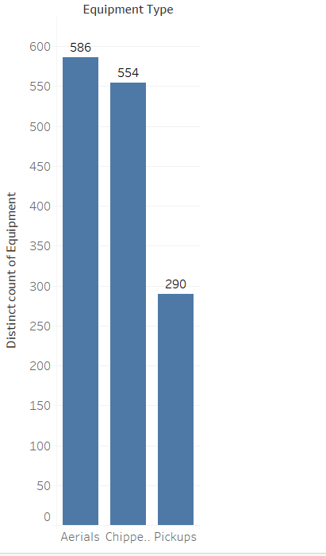
Data Overview
Years: 2001-2017
Variables chosen: Tower type, Trans type, Wheels driven by,
Vehicle manufacturer, Installed Location, Apportioned,
Engine Manufacturer, Engine model, Engine configuration,
Ownership code, Age, Year, LID, Fuel,Purchase Price,Billing hours
Total number of CAPs: 1430
Missing percentage:
23% in complete data
11% in Aerials
33% in chippers
23% in Pickups

Slide 5
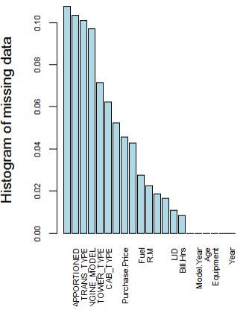
AERIALS: Missing Variable Values Replacement
Deleted the rows with > 50% missing
Categorical:
Deleted the columns with >10% missing
Replaced with Most frequent value
Numerical:
Deleted the columns with >50% missing
Deleted the rows with R&M costs =$0
Replaced with Median

Slide 6
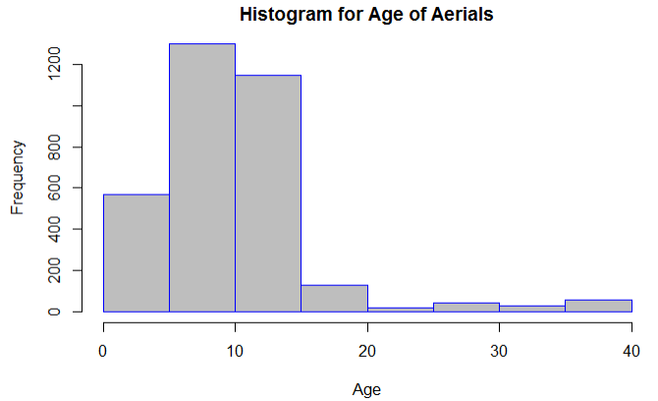

Slide 7
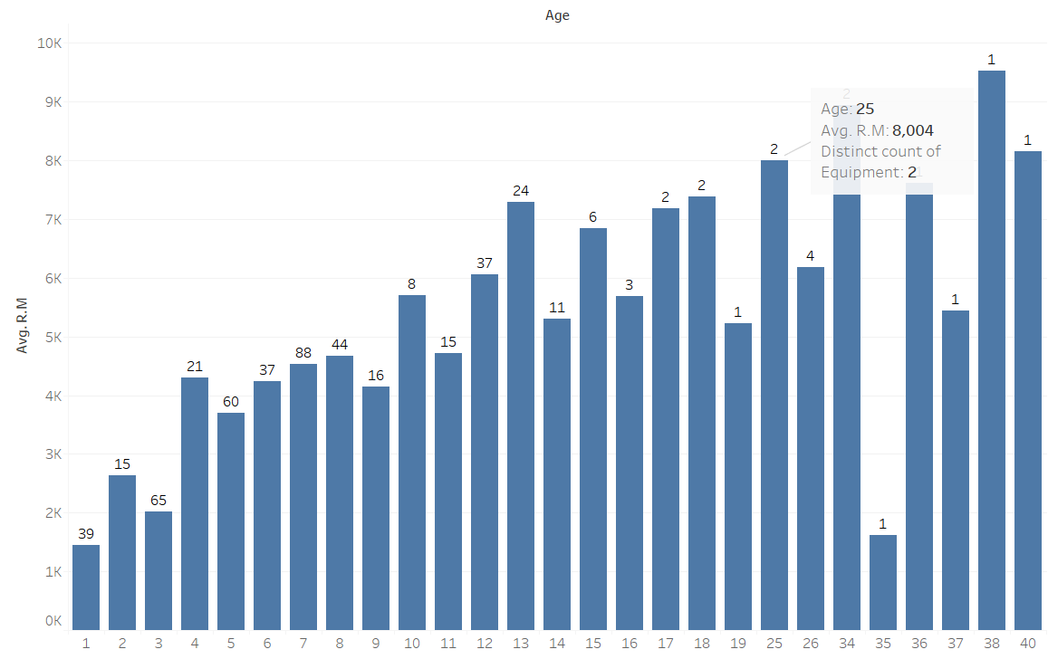
Age and R&M Costs
Notes:
Do not have date for Equipment 3800184, has only 3 years data

Slide 8
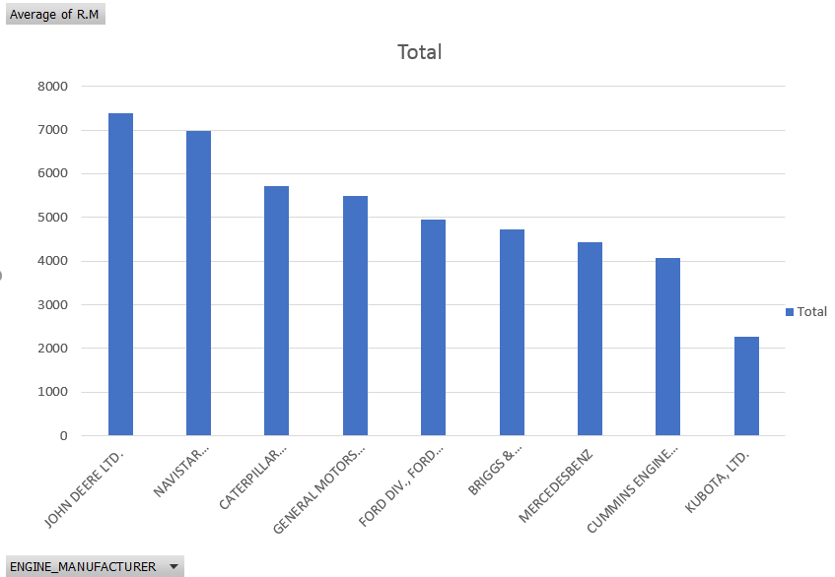
Average R&M Costs By Engine Mfg ($)

Slide 9
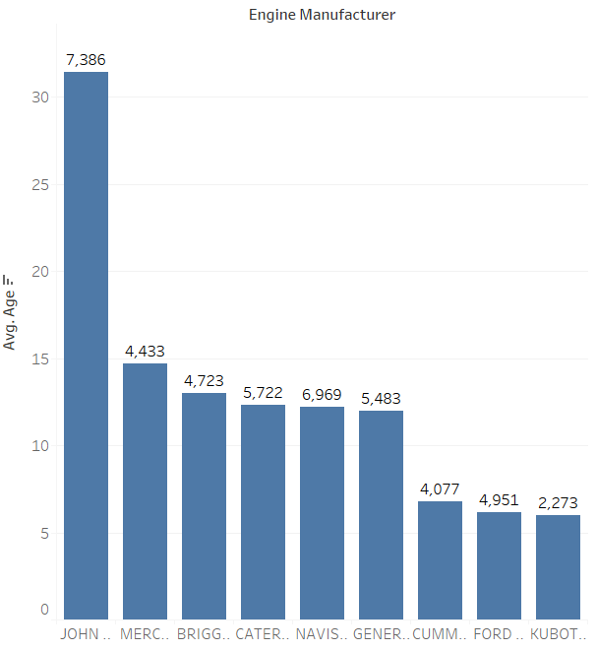
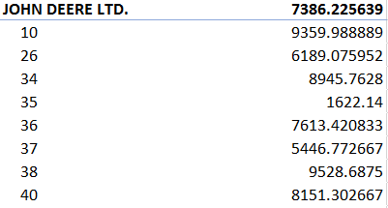
Average age By Engine Mfg (Years)
Notes:
Costs at top

Slide 10
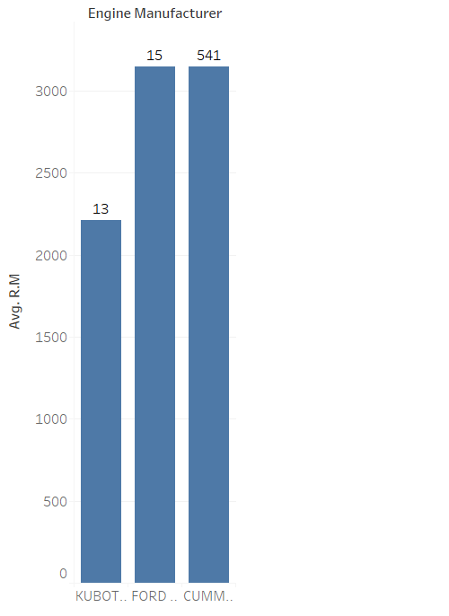
Avg R&M for 5 year old vehicles by Engine Mfg

Slide 11
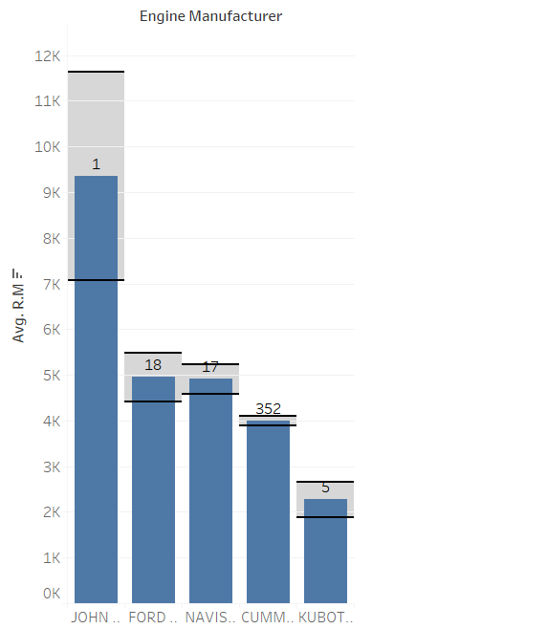
Avg R&M for 10 year old vehicles by Engine Mfg
Notes:
Plot error bars

Slide 12
Variables Removed
Age: Highly correlated to Model year and year and was same for an equipment for all years
Equipment : Unique identifier
Tower serial: Unique identifier
Billing hours : Removed only for Prediction for 2018
Fuel : Removed only for Prediction for 2018
LID : Removed only for Prediction for 2018 as there is no defined method of finding LID
ENGINE_MODEL was highly correlated to Engine manufacturer
Vehicle manufacturer(Correlated with Engine manufacturer)
Notes:
Altec as VM, then Cummins as EM
John Deere as VM has John Deere as EM
Remove age

Slide 13
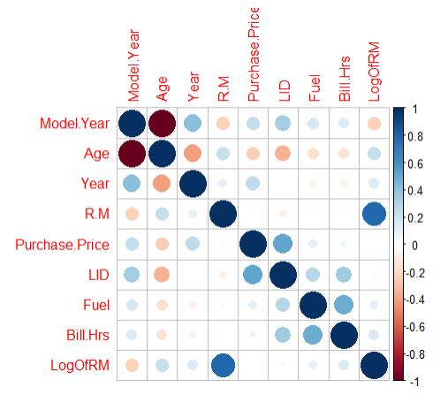
Correlation Graph for Aerials
Age and R&M: 23%
Model Year and R&M: -23%
R square of 44% on Training data
R square of 32% on Test data
R square is 31% without LID,Bill.Hrs and Fuel
R square is 18% without LID,Bill.Hrs and Fuel

Slide 14
Effect of Different Attributes on R&M
Year : 0.21 (1 year increase is making an increase of 21% increase in R&M costs)
Model year: -0.15
Bill Hours: 0.10
LID : 0.45
ENGINE_CONFIGURATIONV 8 CYL. 1.47
ENGINE_CONFIGURATION 6 CYL. (INLINE) 1.32
ENGINE_MANUFACTURERJOHN DEERE LTD -1.22
Purchase.Price -0.17
Notes:
exp(0.19)=1.21-1= 21% increase

Slide 15
Effect of Location Attributes on R&M
Peabody Municipal Power Plant: -3.96
Florida Public Utilities Northeast:-1.35
OUC Production: -0.73
Jones Onslow: -1.26
PSEGDistribution Firm Bid : -0.97
FirstEnergy JCPL Firm Bid: -0.88
DTE Unit Maintenance Work: -0.66
NIPSCO T&M:-0.92
NIPSCO: -0.79
Ohio Cooperatives: -0.68
National Grid New England:0.08
City of Cuyahoga Falls: -1.22

Slide 16
Most important Predictors
LID
Year
Installed location
Engine manufacturer
Ownership code(Own,lease,Chng)
Model year
Bill hours
Tower type
Engine Configuration
Drive Train Type (4x4, 4x2)
Fuel

Slide 17
R&M costs Predictions 2018
Equipment | 2017 R&M costs($) | Predicted 2018 R&M costs($) | 95% Confidence interval($)
3200883 | 36,745 | 7,163 | 4,475-11,465
3001246 | 4,553 | 15,093 | 11,335-20,098
3001109 | 7,743 | 17,373 | 10,071-29,970
3800173 | 18,423 | 13,700 | 7,344-25,556
Notes:
Difference of r&M in years

Slide 18
Variables which will have high Predictive power
Last Read Odometer readings/Miles(can be taken every month)
Have a Maintenance Table with:
Work order number, Date of start & end(Downtime), WO reason(Repair or maintenance), WO Description(repair,maintenance), Labor Hours, Labor Costs, Odometer reading during WO, Job status code(Done/pending), location of repair
Body manufacturer , Body_model(had lot of missing values)
Likelihood of failure of an equipment: Highly, marginal, least

Slide 19
Future Possibilities
Have separate fields for Repair and maintenance.
Have separate fields for Licence, Insurance, Tax and Depreciation.
External repairs are added into the same “Other” GL account and are not mapped into unit numbers
Predicting resale values/residual values of active vehicles
Defining Business Metrics(Total Ownership costs,Return on investment)
Telematics for real time data collection and failure prediction
Status code: Disposed(D), Active(A)
Warranty costs
Planned Maintenance to Predictive maintenance(Mean time before failure)
Notes:
Train and test

Slide 20
Thank you!

